Slide 1
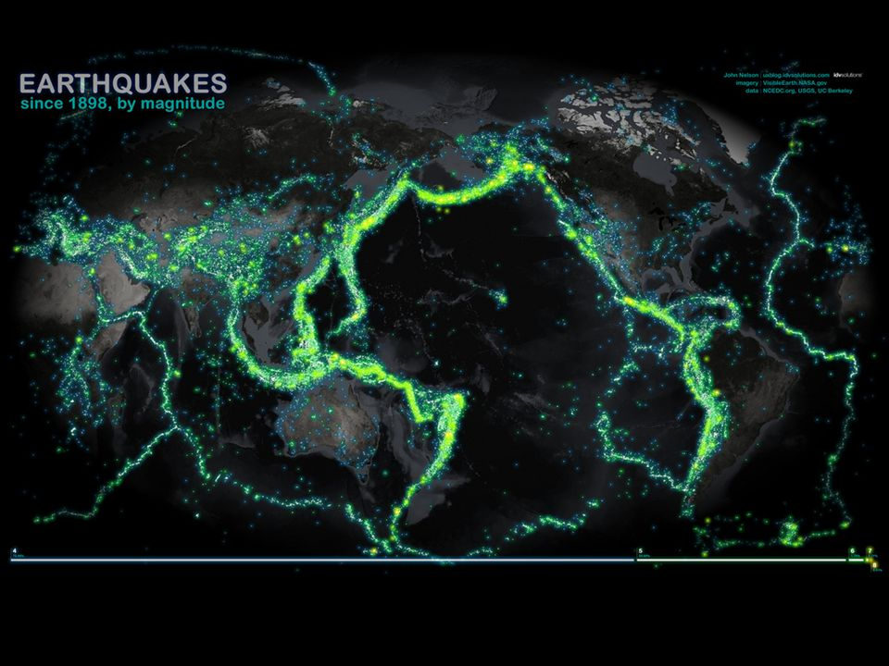

Slide 2
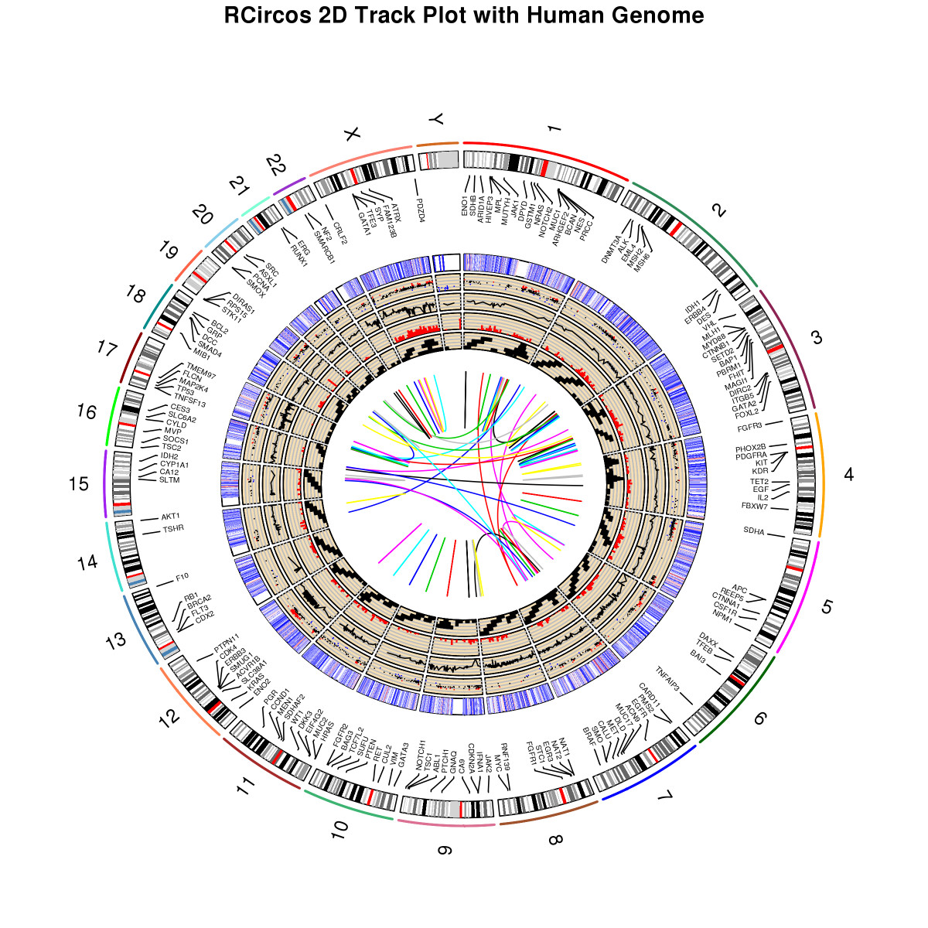
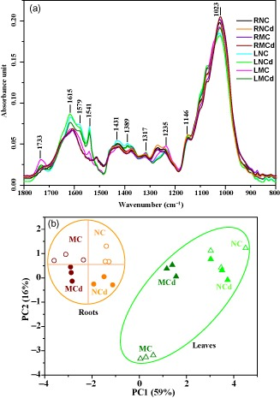

Slide 3
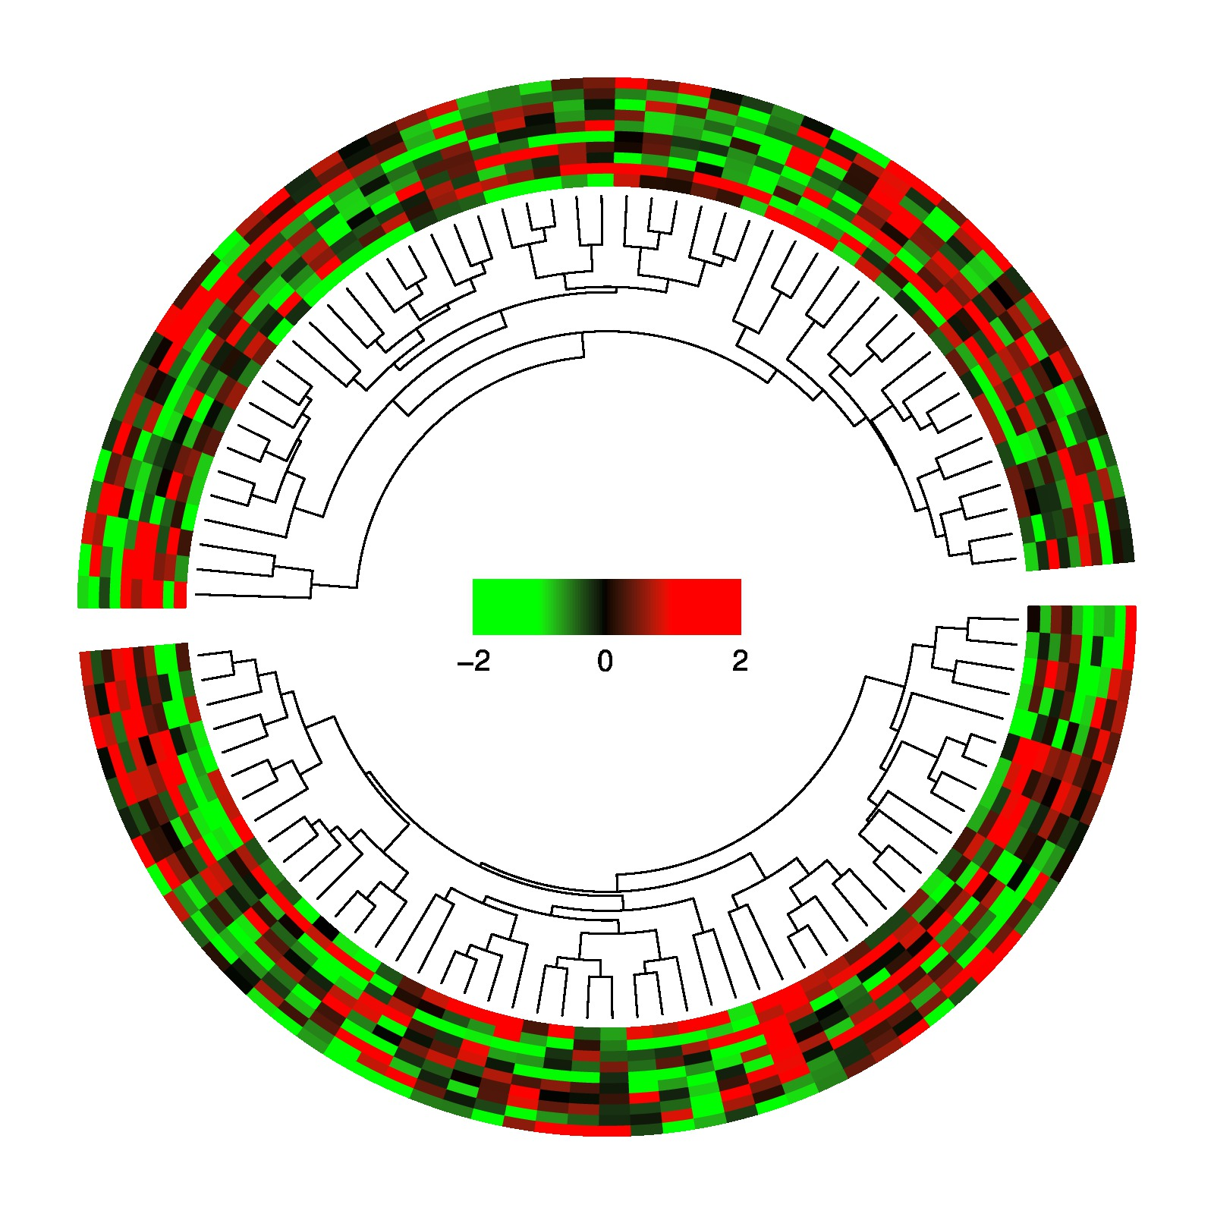
library(circlize)
# dend: as dendrogram object, usually returned by hclust and as.dendrogram
# maxy: maximum height of the tree
circos.dendrogram = function(dend, maxy) {
labels = as.character(labels(dend))
x = seq_along(labels) - 0.5
names(x) = labels
is.leaf = function(object) (is.logical(L <- attr(object, "leaf"))) && L
# recursive function to draw the tree
draw.d = function(dend, maxy) {
leaf = attr(dend, "leaf")
d1 = dend[[1]]
d2 = dend[[2]]
height = attr(dend, 'height')
midpoint = attr(dend, 'midpoint')
if(is.leaf(d1)) {
x1 = x[as.character(attr(d1, "label"))]
} else {
x1 = attr(d1, "midpoint") + x[as.character(labels(d1))[1]]
}
y1 = attr(d1, "height")
if(is.leaf(d2)) {
x2 = x[as.character(attr(d2, "label"))]
} else {
x2 = attr(d2, "midpoint") + x[as.character(labels(d2))[1]]
}
y2 = attr(d2, "height")
circos.lines(c(x1, x1), maxy - c(y1, height), straight = TRUE)
circos.lines(c(x1, x2), maxy - c(height, height))
circos.lines(c(x2, x2), maxy - c(y2, height), straight = TRUE)
if(!is.leaf(d1)) {
draw.d(d1, maxy)
}
if(!is.leaf(d2)) {
draw.d(d2, maxy)
}
}
draw.d(dend, maxy)
}
mat = matrix(rnorm(100*10), nrow = 10, ncol = 100)
factors = rep(letters[1:2], 50)
par(mar = c(1, 1, 1, 1))
circos.par(cell.padding = c(0, 0, 0, 0), gap.degree = 5)
circos.initialize(factors, xlim = c(0, 50))
maxy = 0
f = colorRamp2(breaks = c(-1, 0, 1), colors = c("green", "black", "red"))
circos.trackPlotRegion(ylim = c(0, 10), bg.border = NA, panel.fun = function(x, y) {
sector.index = get.cell.meta.data("sector.index")
m = mat[, factors == sector.index]
dend.col = as.dendrogram(hclust(dist(t(m))))
maxy = ifelse(maxy > attr(dend.col, "height"), maxy, attr(dend.col, "height"))
assign("maxy", maxy, envir = .GlobalEnv)
m2 = m[, labels(dend.col)]
nr = nrow(m2)
nc = ncol(m2)
for(i in 1:nr) {
for(j in 1:nc) {
circos.rect(j-1, nr-i, j, nr-i+1, border = f(m2[i, j]), col = f(m2[i, j]))
}
}
})
circos.trackPlotRegion(ylim = c(0, maxy), bg.border = NA, track.height = 0.3, panel.fun = function(x, y) {
sector.index = get.cell.meta.data("sector.index")
m = mat[, factors == sector.index]
dend.col = as.dendrogram(hclust(dist(t(m))))
circos.dendrogram(dend.col, maxy)
})
circos.clear()
x = seq(-10, 10, length.out=100)/40
col =f(seq(-2, 2, length.out = length(x-1)))
for(i in seq_along(x)) {
if(i == 1) next
rect(x[i-1], -0.05, x[i], 0.05, col = col[i], border = col[i])
}
text(x[1], -0.08, "-2", adj = c(0.5, 1), cex = 1.2)
text(x[ceiling(length(x)/2)], -0.08, "0", adj = c(0.5, 1), cex = 1.2)
text(x[length(x)], -0.08, "2", adj = c(0.5, 1), cex = 1.2)

Slide 4

An introduction to data analysis using R
Marc A.T. Teunis, Ph.D.
see slides @: http://www.innovativetesting.nl/cprprogramming

Slide 5
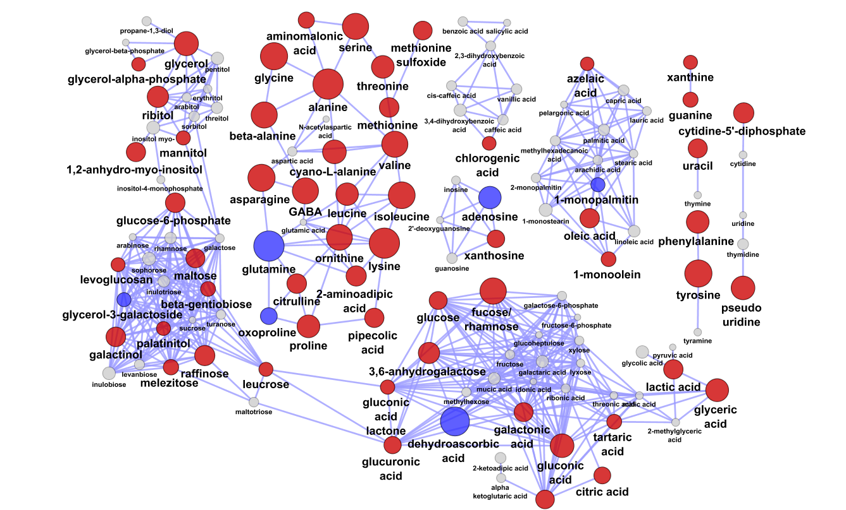
Aim of the day
Today's aims:
1) demonstrate (some) of the possibilities of using R for data analysis
2) Explain a few basic concepts:
- Literate programming
Reproducible research
Open source software
Data analysis workflow

Slide 6

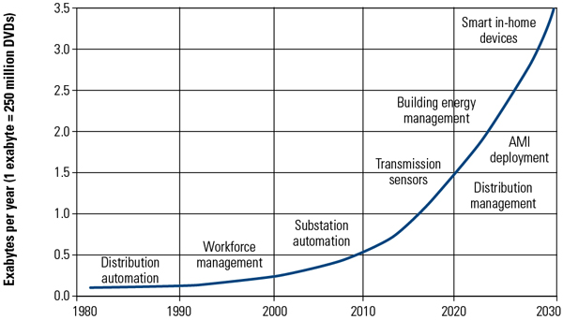
The amount of data is growing
http://www.powermag.com/Assets/Image/Imports/20130101/010113_CS_R&D_Fig5.jpg

Slide 7
Why I use R
It makes reproduction of analyses and making graphs possible
Many, many applications (packages/libraries)
Good resources available (web, books, moocs, courses)
It's free!
It's open source!
There is a very large R community of developers (100.000 LinkedIn)
Number possible applications is enormous
It can be combined in a ‘literate programming’ approach
The graphs you can make are very nice!

Slide 8
The R ecosystem
Github.com (a.o.)
{devtools}
{slidify}
{lamabodyr}
CRAN
{dplyr}
{ggplot2}
{rprojroot}
{readr}
{tidyr}
Rstudio
read.csv(“…”)
R base
BIOCONDUCTOR
{IRanges}
{Biostrings}
{ComplexHeatmap}
{msmsEDA}
{affy}
123456
Asdfghj
Wwwerty
1112333

Slide 9
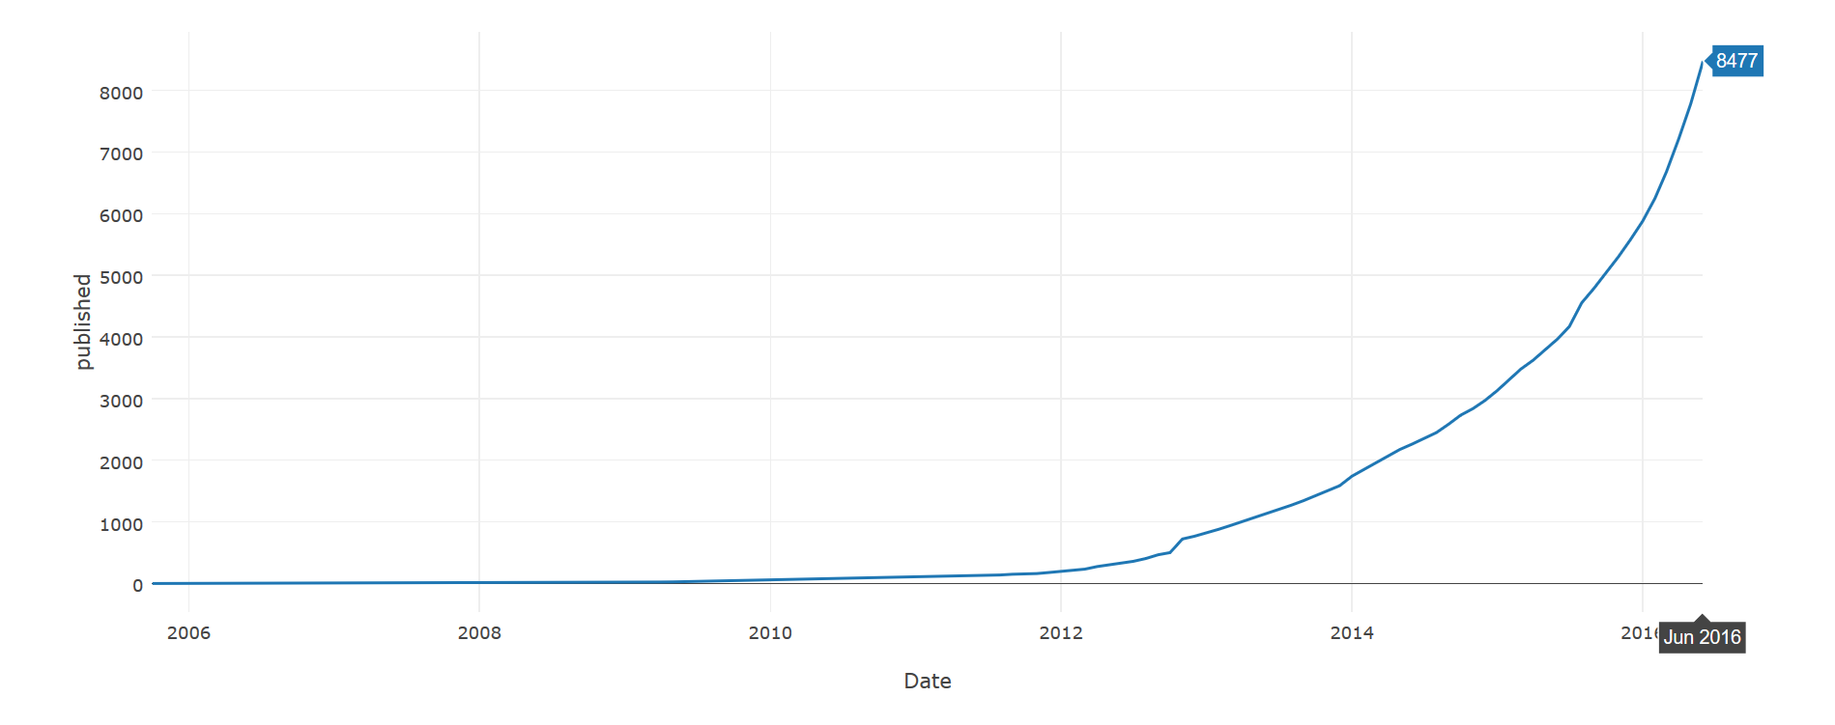
Number of packages – 2006 to 1 june 2016
url <- "https://cran.r-project.org/web/packages/available_packages_by_date.html"
page <- read_html(url)
page %>%
html_node("table") %>%
html_table() %>%
mutate(count = rev(1:nrow(.))) %>%
mutate(Date = as.Date(Date)) %>%
mutate(Month = format(Date, format="%Y-%m")) %>%
group_by(Month) %>%
summarise(published = min(count)) %>%
mutate(Date = as.Date(as.yearmon(Month))) -> pkgs
margins = list(l = 100, r = 100, b = 100, t = 100, pad = 4)
pkgs %>%
plot_ly(x=Date, y=published, name="Published packages") %>%
layout(title = "CRAN packages published ever since.", margin = margins)

Slide 10
Data analysis work flow
Experiment
Raw data
Data frame?
Getting data in R
Clean data
Exploratory data analysis
Check assumptions
Perform statistical analysis
Conclusion
Convert to data frame

Slide 11
Data analysis starts with a (raw) data file
Data file = data frame / matrix / text file / webpage / raw data file
User must be sure to use the correct (raw) data -> README.txt
No graphs etc. included in the MS Excel tab with raw data
Non-proprietary formats: *.csv / *.txt are the best!
Reading MS Excel files is possible
Never edit data (cells) in the original data file!!

Slide 12
The data frame - "Tidy data"
Tidy data is formatted in a standard way that facilitates exploration and analysis and works seamlessly with other tidy data tools.
Specifically, tidy data satisfies at least the conditions:
Start at cell A1
First row is header with variable names
Each variable forms a column
2) Each observation forms a row
3) Each type of observational unit forms a table
4) Variables are named according a few strict rules

Slide 13

Missing values?
Do not leave cells blank
Do not delete or change any observation from the data file
Use NA as designator
Using NA ensures possibility to combine data from different experiments (include index variable "unique SampleID")

Slide 14
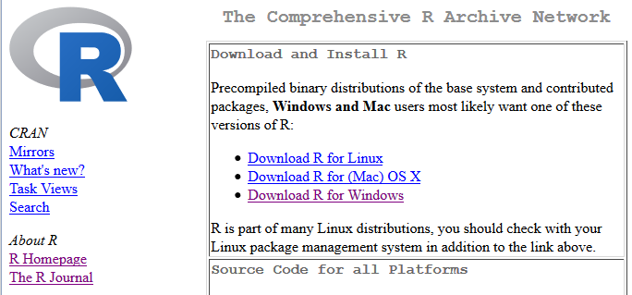
Getting R on your computer
Install R from the Comprehensive R Archive Netwok:
https://cran.r-project.org/
Choose the appropriate version for your OS. Try it now!
Notes:
CRAN: The Comprehensive R Archive Network
The File Transfer Protocol (FTP) is a standard network protocol used to transfer computer files between a client and server on a computer network.
GUI: graphical user interface

Slide 15

RStudio™: An R IDE (Integrated development environment)
RStudio v0.99.1292 Preview
https://www.rstudio.com/products/rstudio/download/preview/

Slide 16

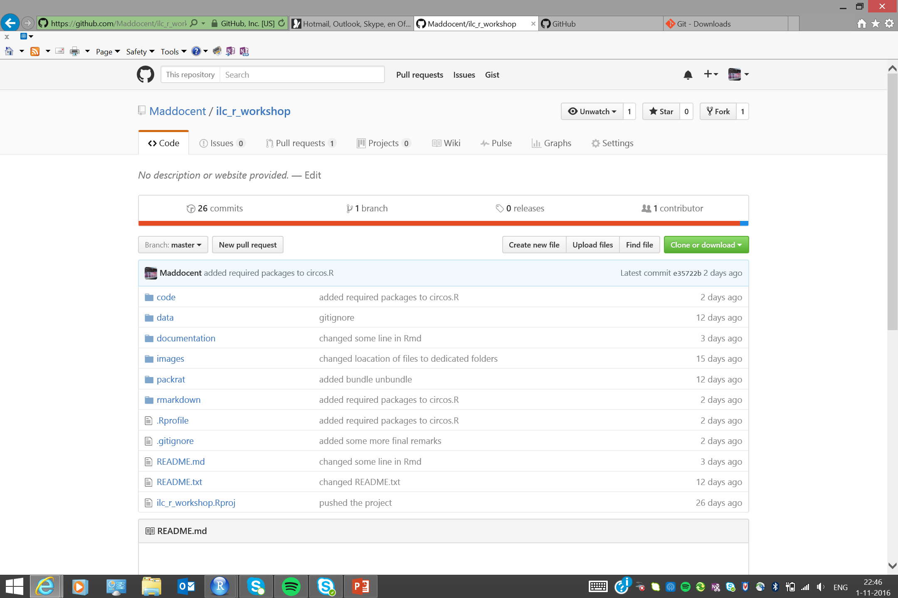
Git / Github
www.github.com create an account
download zipfile: https://github.com/Maddocent/ilc_r_workshop/archive/master.zip
https://git-scm.com/download/ download the file for your OS, install the program

Slide 17
For HU-laptop users
Setting up your system to use R and RStudio

Slide 18
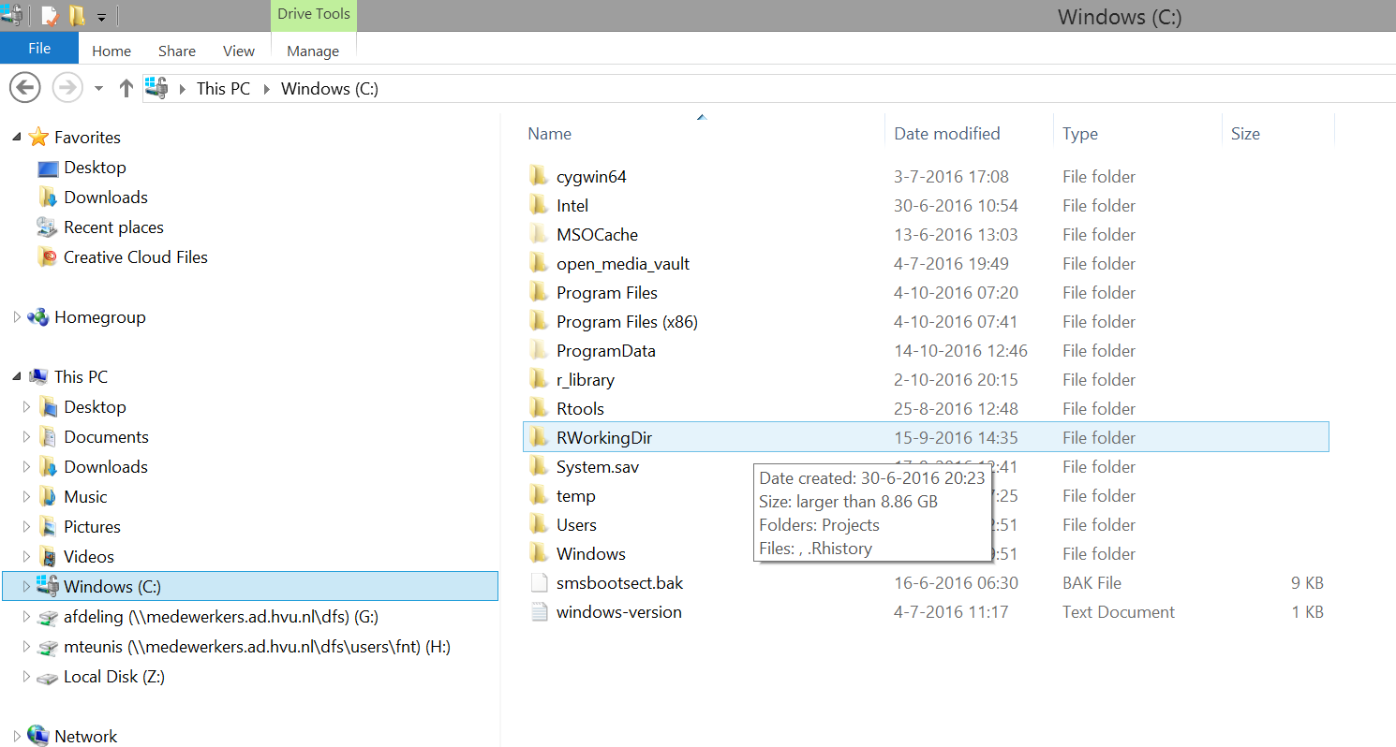
Create folders: "C:/RWorkingDir" and C:/r_library
Create a new folder "c:/RWorkingDir"

Slide 19
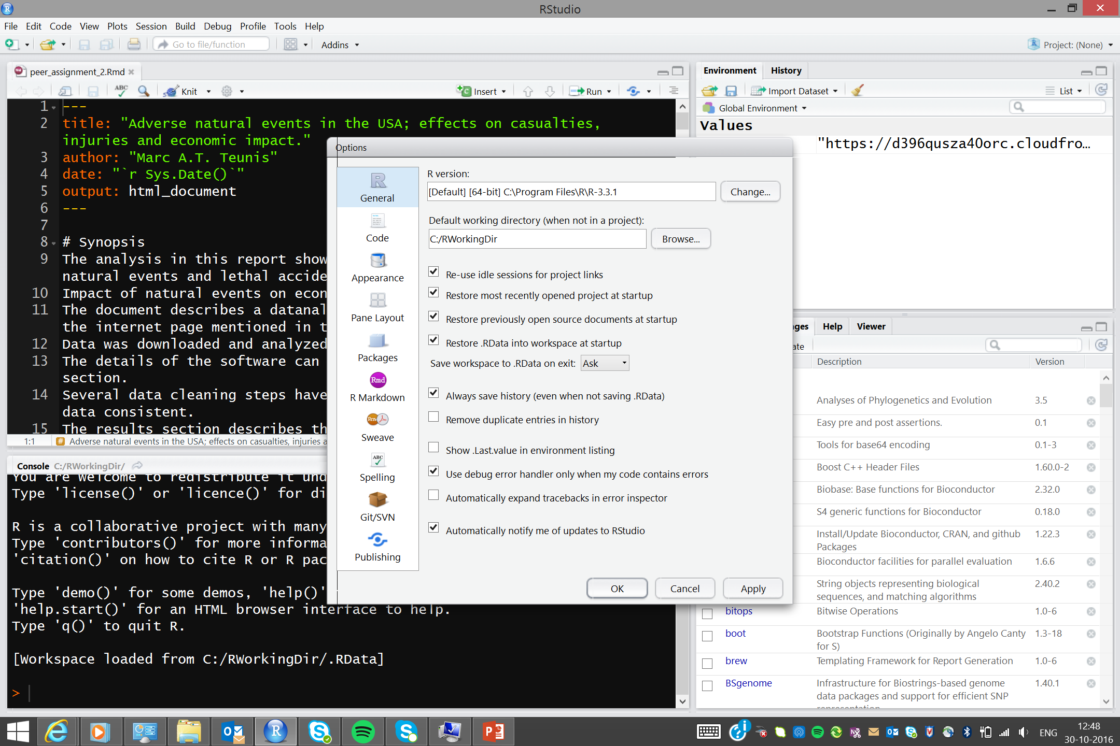
Add new directory to RStudio

Slide 20
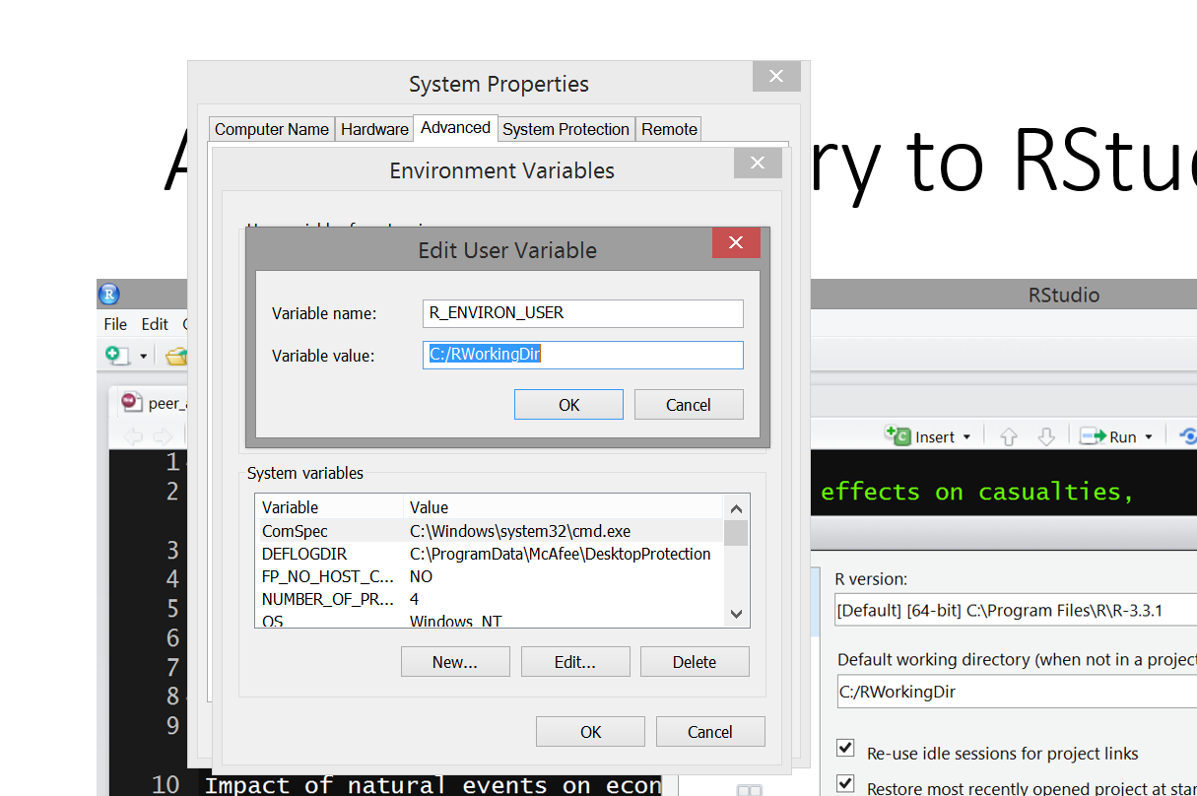
Add RWorkingDir folder to system variables

Slide 21
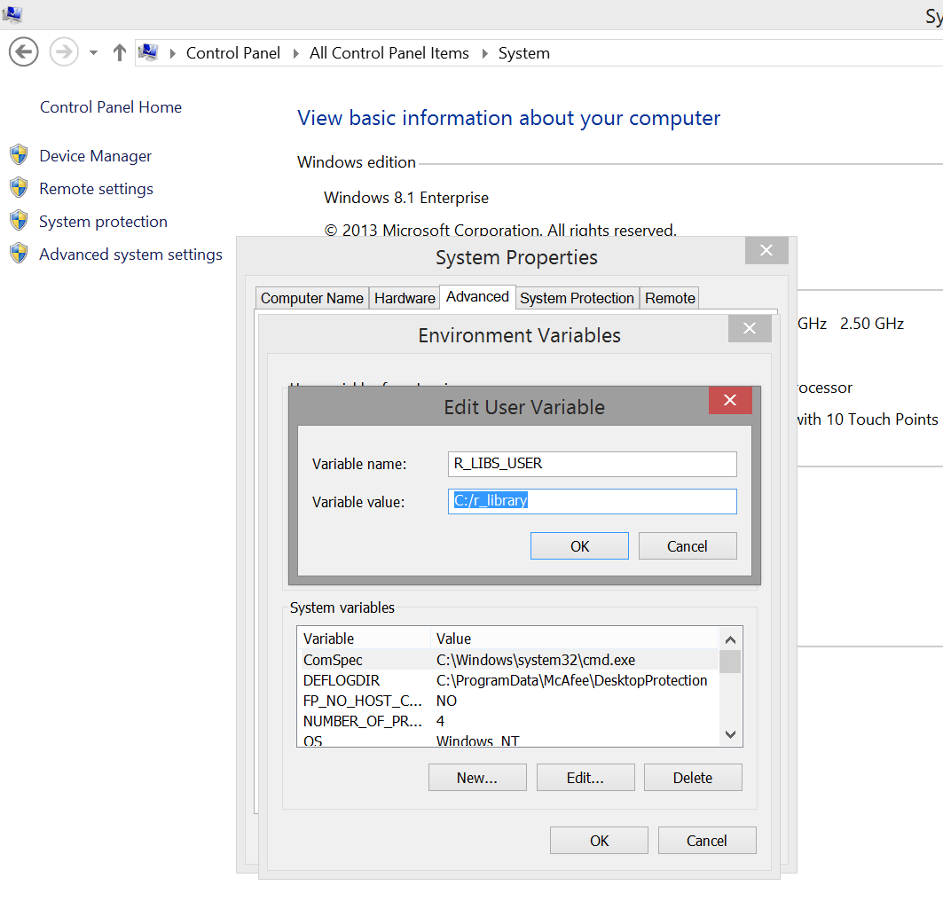
Add library
folder to system variables

Slide 22
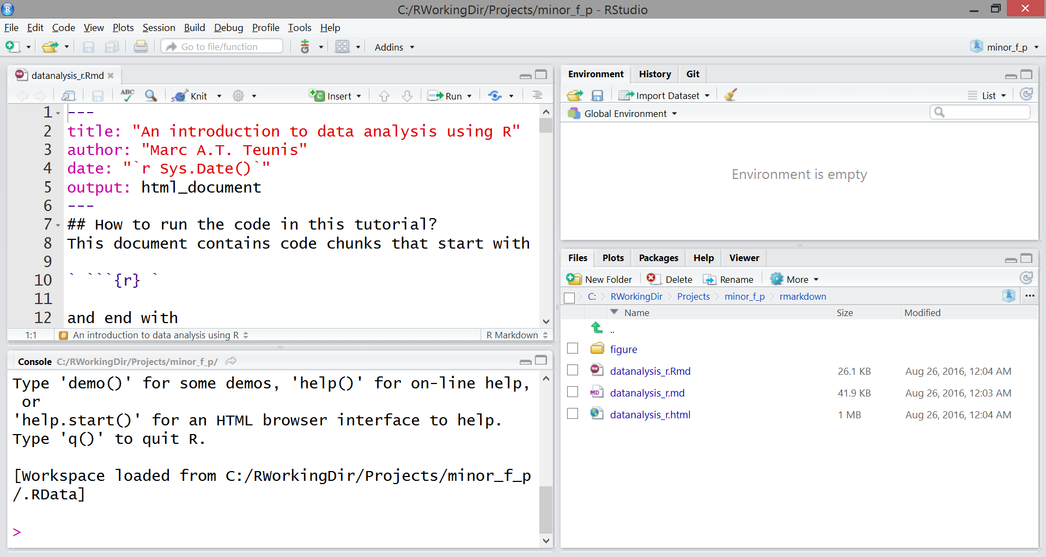
RStudio Software layout
Script editor
Global Environment
Files, Plots,
Help, Packages
Console

Slide 23
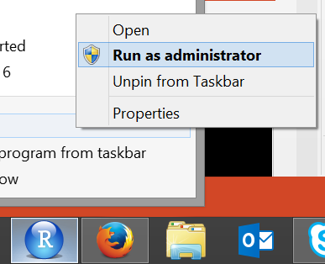
Start interactive part
Interactive session using Rstudio
Download the repository “ilc_workshop” on Github.com
Unzip file to "RWorkingDir"
Open project "ilc_r_workshop.Rproj"
Open file "./rmarkdown/workshop_r_ilc.Rmd"
Run code chunk with keys "Cntrl", "Shift" and "Enter" simultaneously
Run code line with keys: "Cntrl" and "Shift" simultaneously
Select code by dragging left-click mouse, run highlighted code with: "Cntl" and "Shift" simultaneously
Go to RStudio: On Windows run program as "administrator"

